Slide 1


Getting Started with
Generative AI
(LLMs Edition)
Hrishikesh Yadav

Slide 2
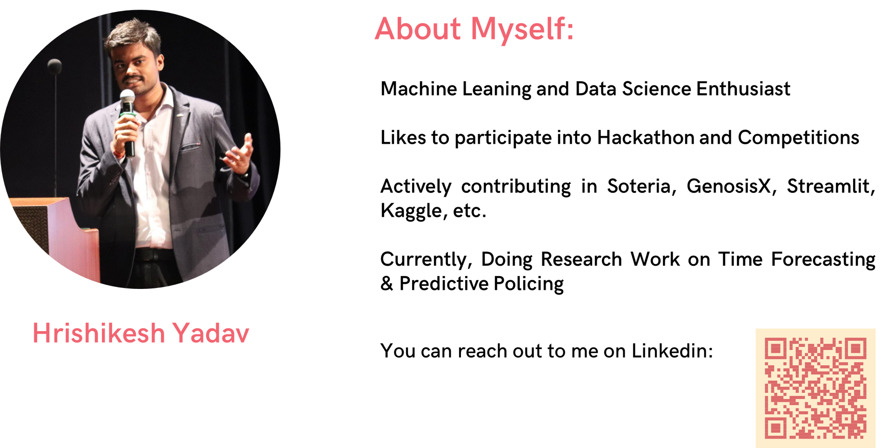



ABOUT
Machine Leaning, Data Science and Applied Generative AI Enthusiast
Likes to participate into Hackathon and Competitions
Actively contributing in Soteria, GenosisX, Streamlit, Kaggle, etc.
Currently, Doing Research Work on Predictive Policing and Applied Generative AI
Co-Founder @RetroNexus
Member @SuperTeamDao
AI Lead @TCET OpenSource
AI Instructor @RanchoLabs
Student Ambassador @Strealmit

Slide 3

TABLE OF CONTENTS
1
Understanding LLMs
2
How Does it work
3
Why Generative AI Now
4
Various Application
5
Prompt Tuning
6
Hands-On for Prompt Tuning
7
Introduction to Langchain and Hands-ON for RAG

Slide 4


Slide 5

KERAS API PHILOSPHY
Progressive Disclosure of Complexity

Slide 6
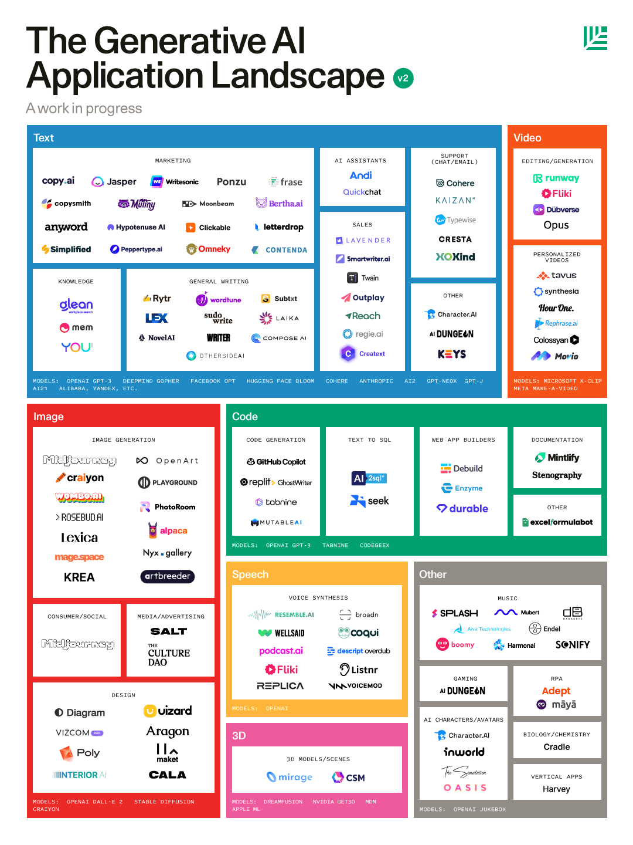




GENERATIVE AI APPLICATION

Slide 7
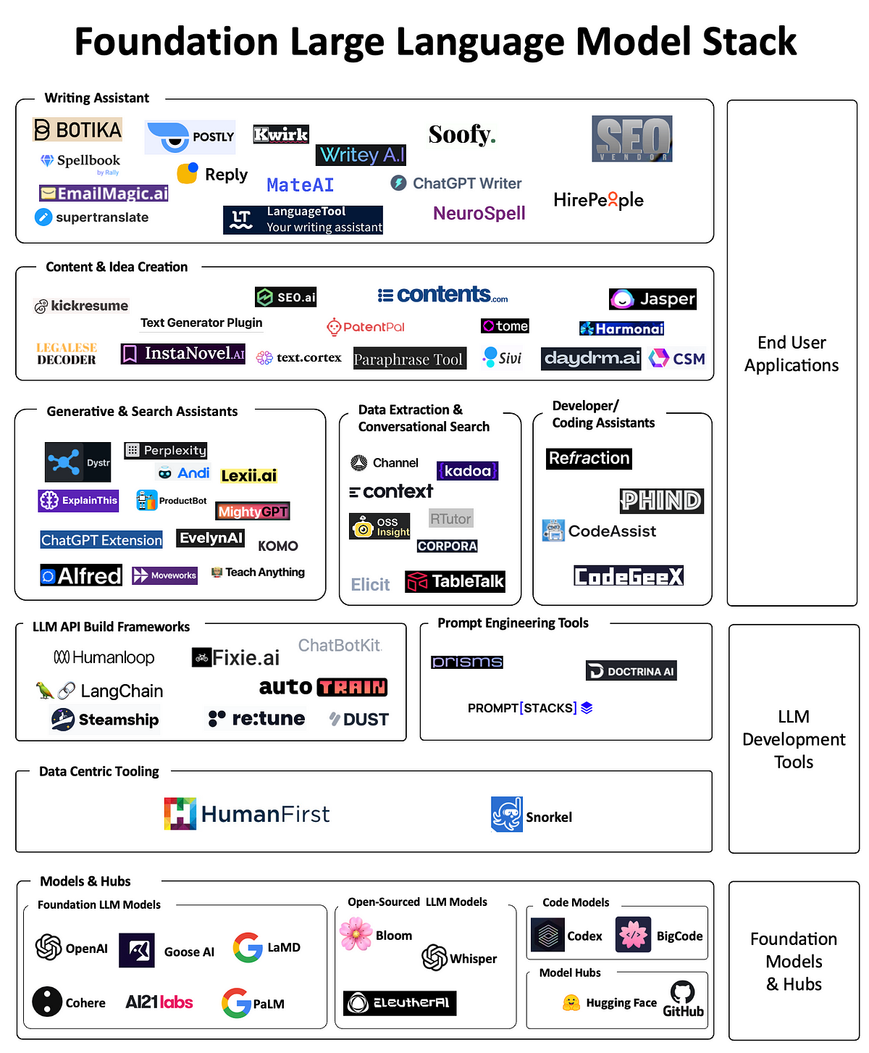
LLM MODEL STACK

Slide 8
LLM MODEL STACK

Slide 9
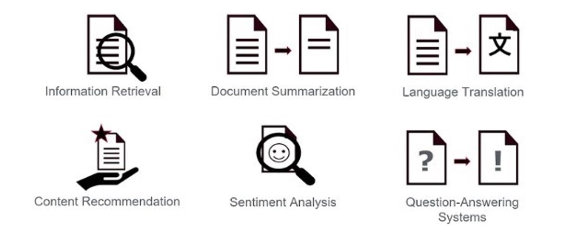
WORKING WITH TEXT

Slide 10
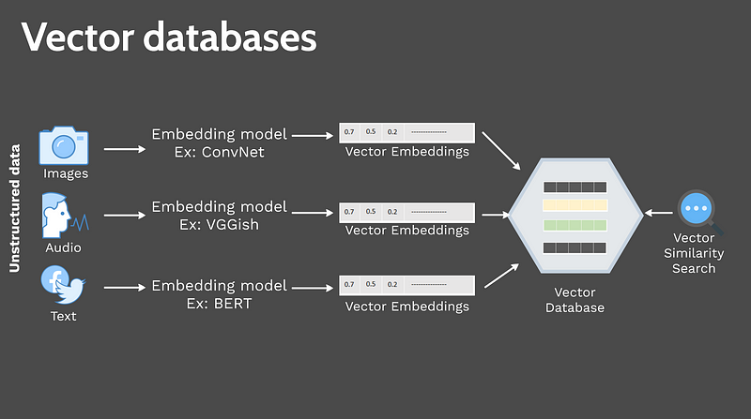
EMBEDDING

Slide 11
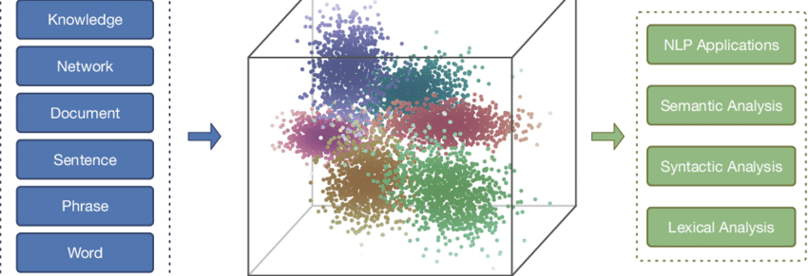
EMBEDDING

Slide 12

WHAT IS
LLM

Slide 13
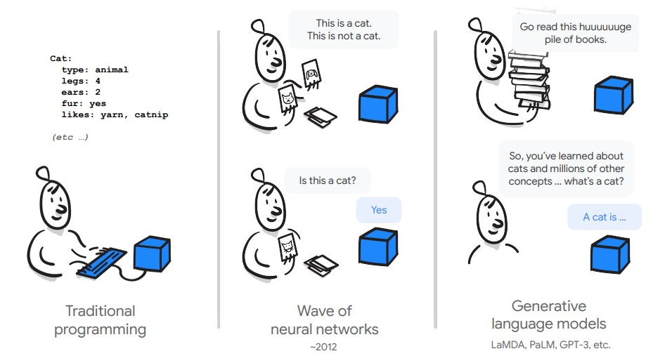
WHAT IS
LLM

Slide 14
WHAT IS
LLM
LLMs are typically trained on datasets large enough to include nearly everything that has been written on the internet.
LLMs can apply their language understanding to tasks they were never explicitly trained.
LLMs are not just for teaching AIs human languages, but for understanding proteins, writing software code, and much more

Slide 15

WHY LLM IS ON BOOM
Changes how we interact with the data
Can find pattern and connections in massive, disparate data corpus

Slide 16
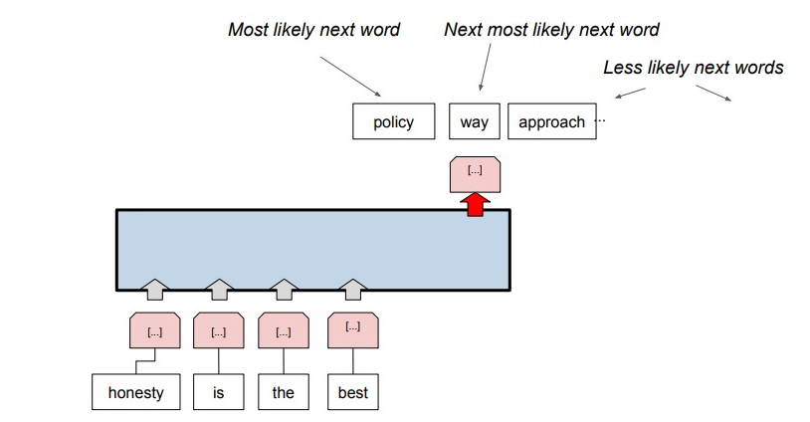
HOW DOES IT WORK

Slide 17
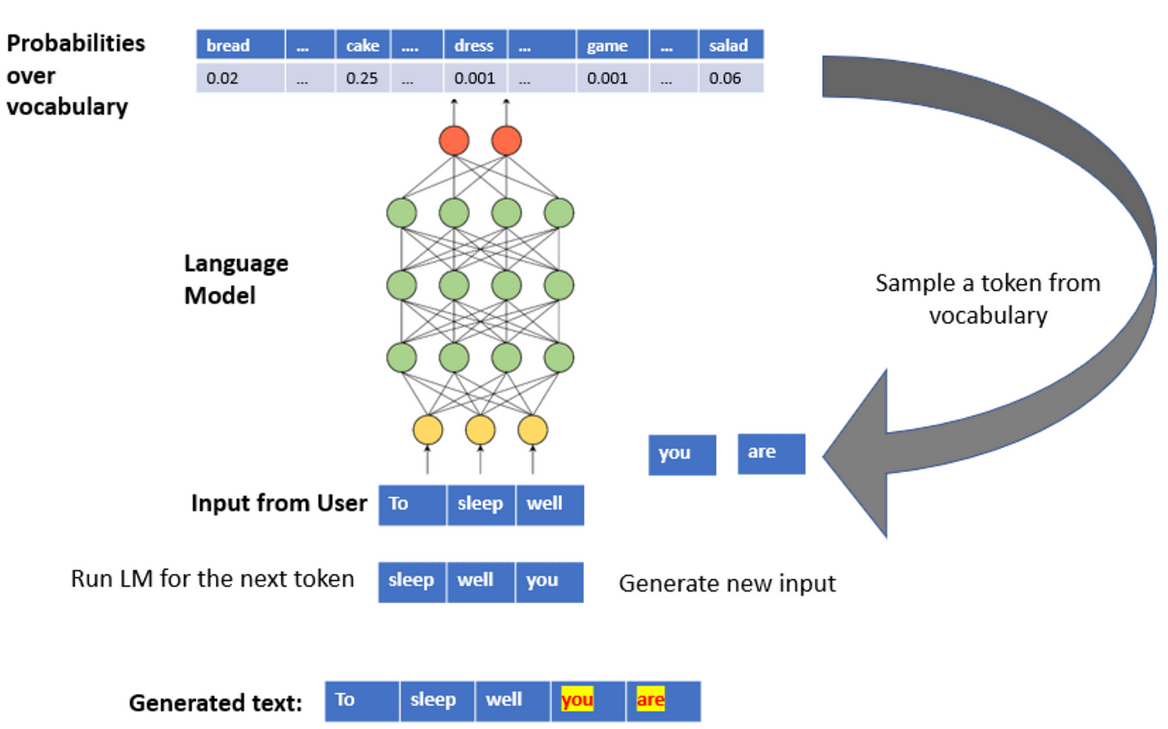
HOW DOES IT WORK
JAYESH

Slide 18
PROMPT ENGINEERING
Input - The sky is full of
Output - [stars(0.6), clouds (0.2), planes(0.002), ...]

Slide 19

PROMPT ENGINEERING
Input - The sky is full of
Output - [stars(0.6), clouds (0.2), planes(0.002), ...]
GREEDY DECODING SAMPLING

Slide 20
PROMPT ENGINEERING
Input - The sky is full of
Output - [stars(0.6), clouds (0.2), planes(0.002), ...]
RANDOM SAMPLING

Slide 21
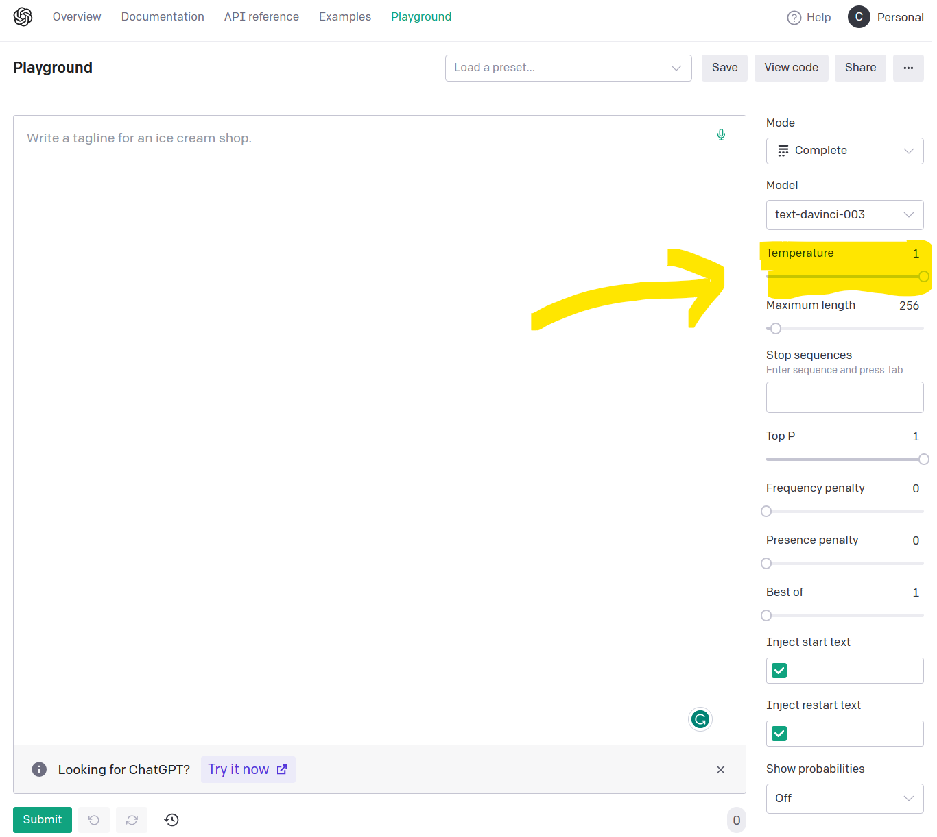
TEMPERATURE

Slide 22
TEMPERATURE
Temperature is a number used to tune the degree of randomness.
Lower temperature →less randomness
High temperature → more randomness

Slide 23
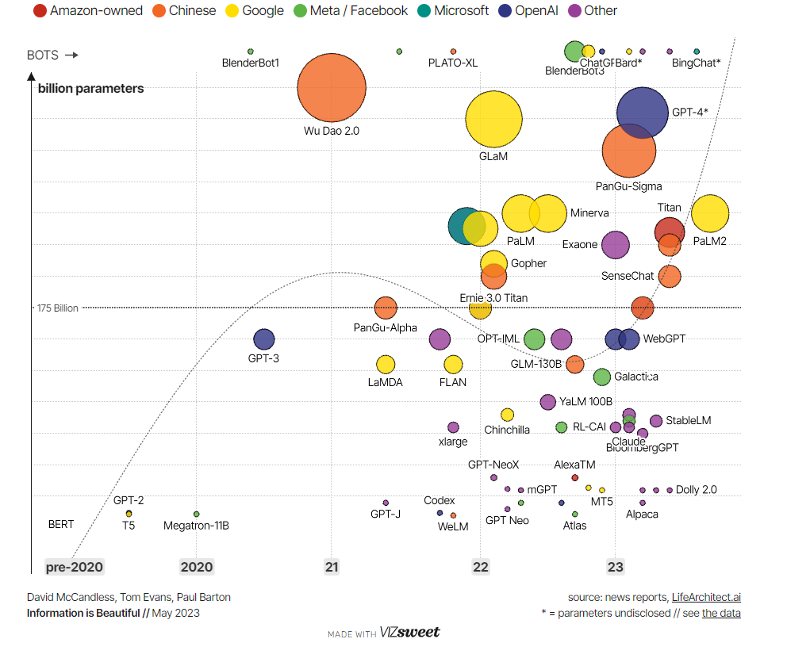
JOURNEY OF
LARGE
LANGUAGE
MODELS

Slide 24

WHY LLM IS ON BOOM
Does not need ML expertise
Does not need to train a model
Need zero training data
Only think about the prompt design

Slide 25
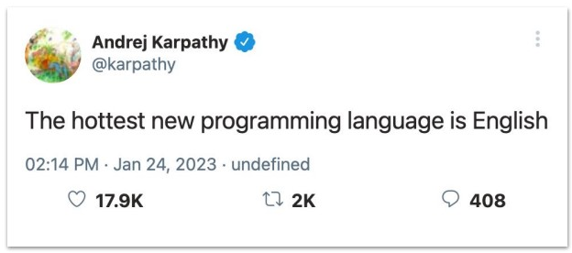
PROMPT DESIGNING

Slide 26
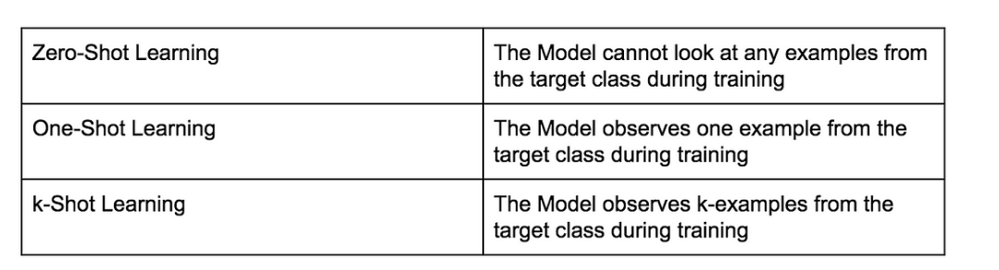
WORKING TYPES

Slide 27
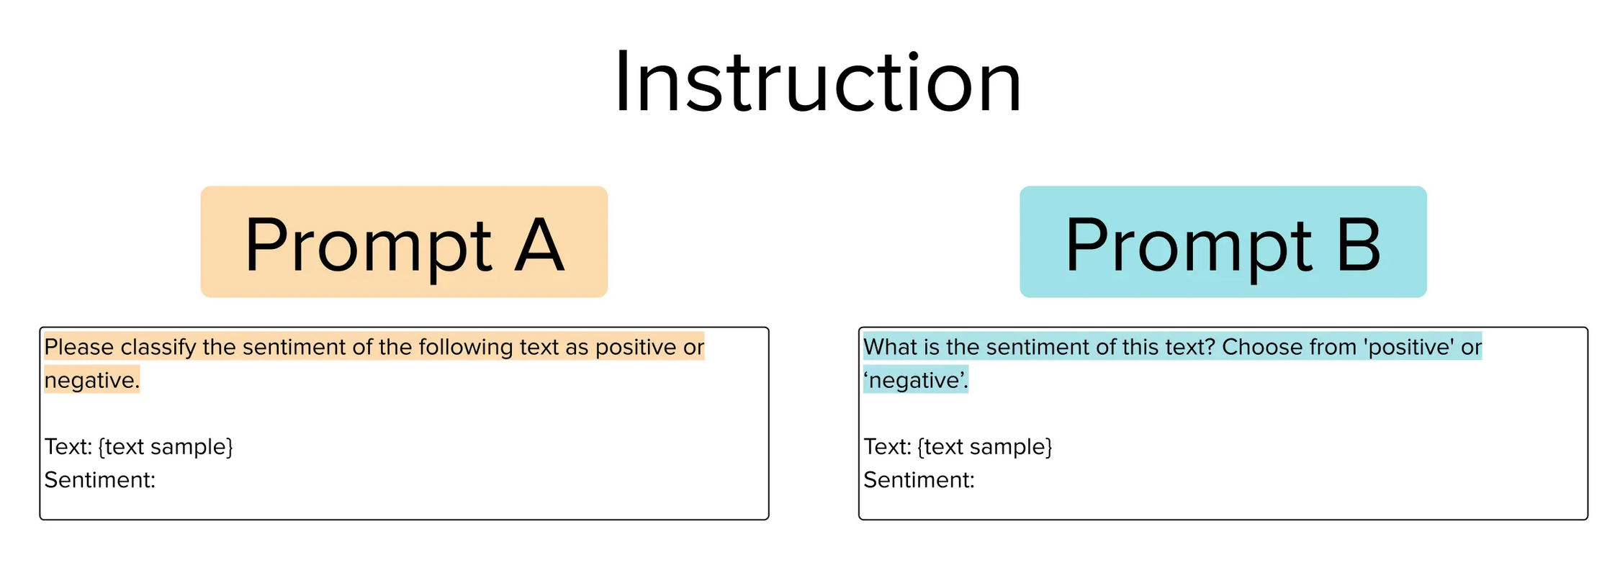
ZERO-SHOT LEARNING

Slide 28
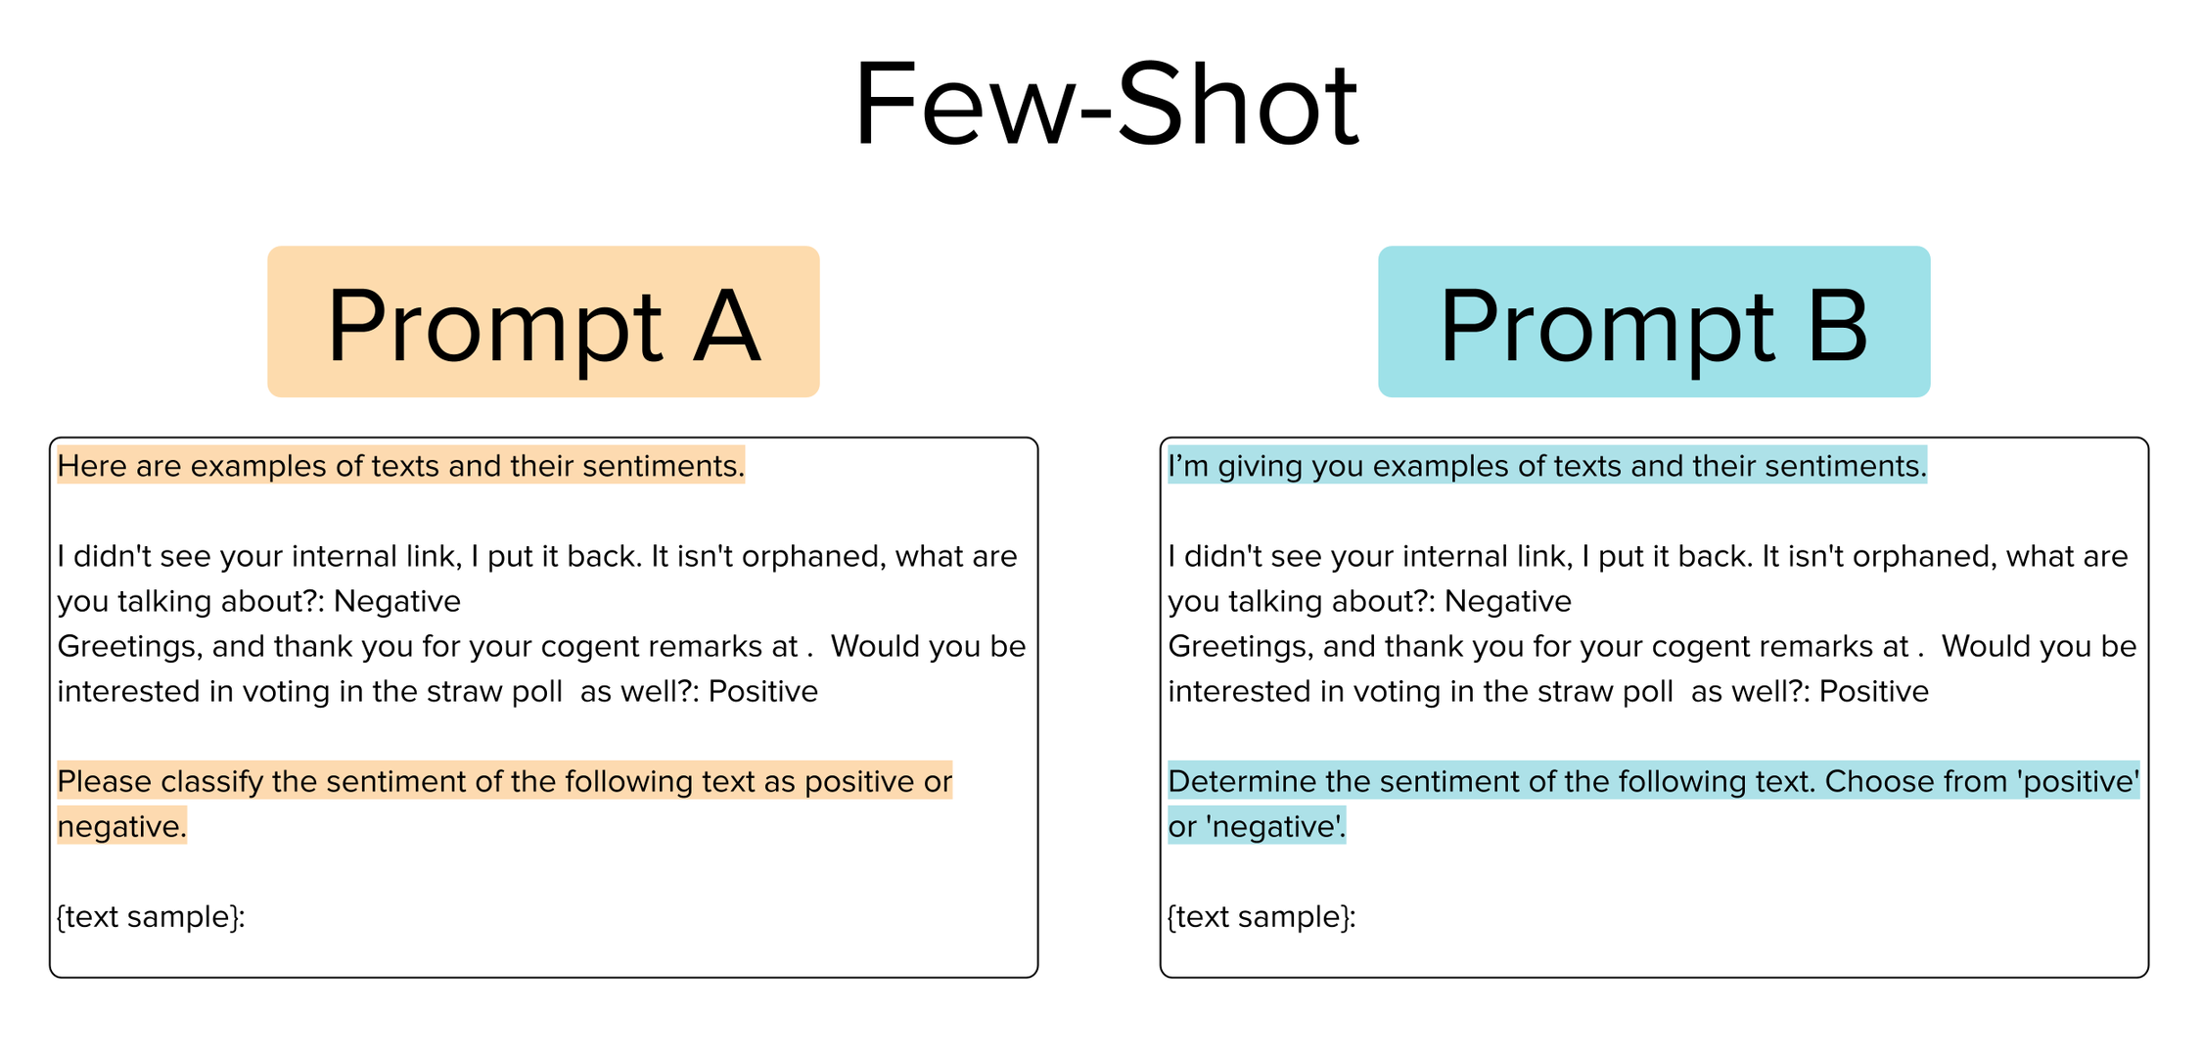
ONE-SHOT LEARNING

Slide 29
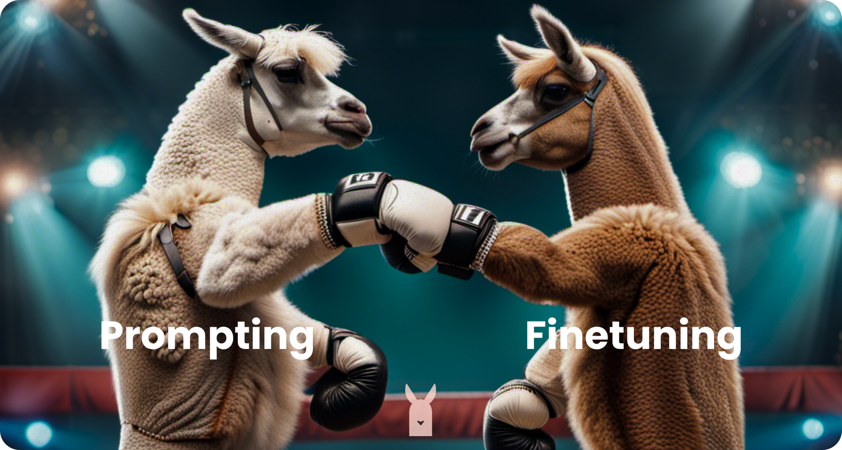
GENERATIVE AI
CREDITS -LAMINI

Slide 30
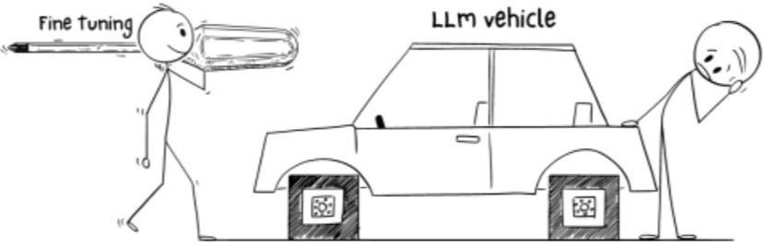
WHY
FINE-TUNING

Slide 31
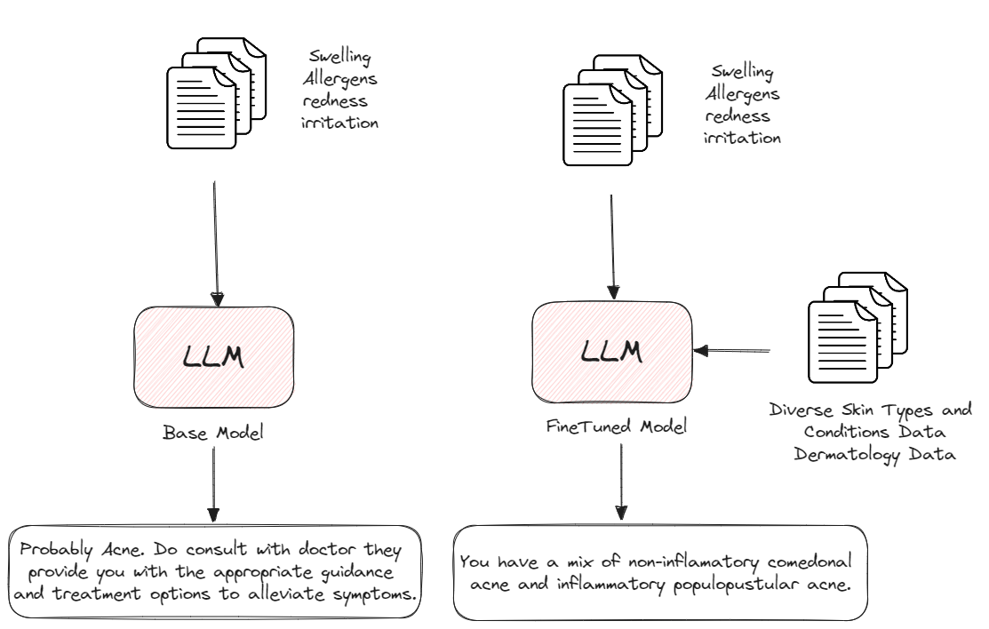
WHY
FINE-TUNING IS NEEDED

Slide 32

WHY
FINE-TUNING IS NEEDED
Domain Specific
Production Usage
Privacy
Stop Hallucination
Reduce unwanted information
Greater Control
Increase Consistency

Slide 33
PROBLEMS WITH FINETUNING
More High Quality of Data
Upfront Compute Cost
Needs Technical Knowledge

Slide 34




GENERATIVE AI FRAMEWORK

Slide 35
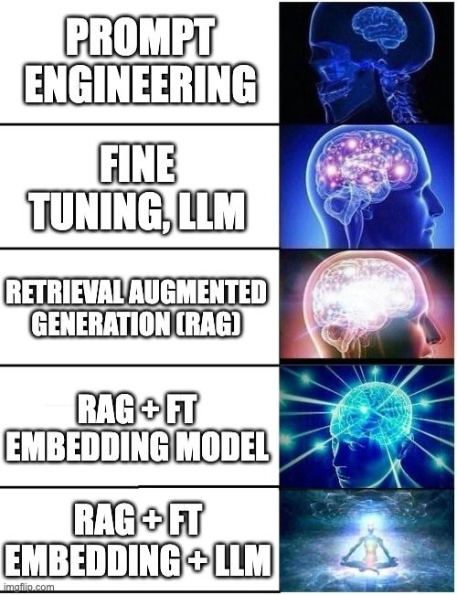
RAG
RAG operates in two main phases: retrieval and content generation
During the retrieval phase, algorithms search for and retrieve relevant snippets of information
In the generative phase, the LLM uses the retrieved information and its internal representation of training data

Slide 36
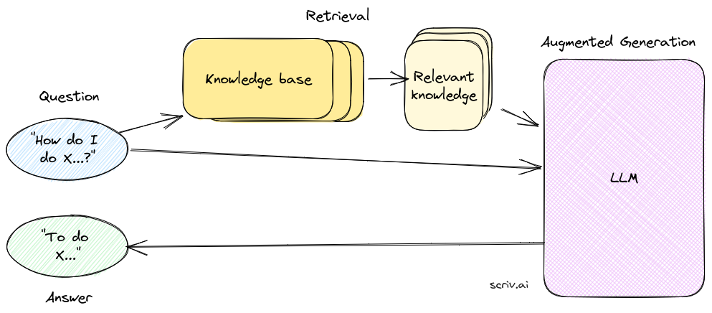
RAG

Slide 37

WHAT IS LANGCHAIN
Langchain simplifies building applications with advanced language models. It occurs as a revolutionary framework that can combine LLM with personalized data sources effectively

Slide 38
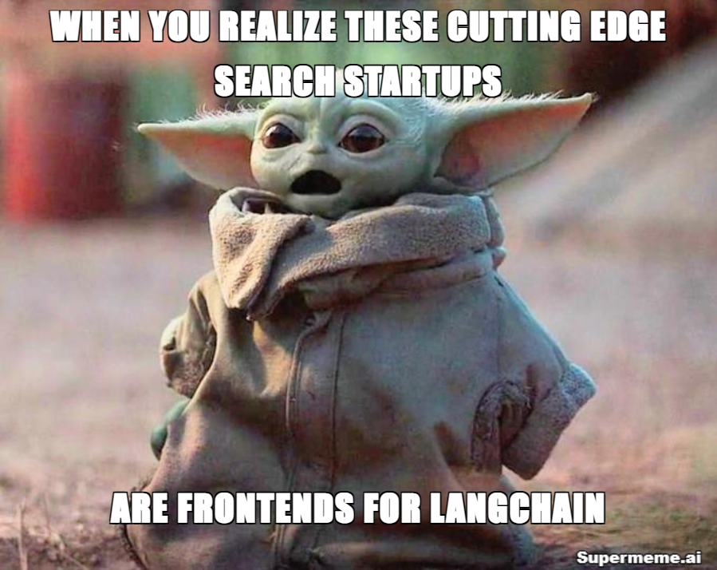
BENEFITS
Cost Saving
Real Time Information
Data Access and Security
Customization and Integration
Potential Use - Chatbot, Personal Assistant, Question & Answering over Docs and Extraction, etc.

Slide 39
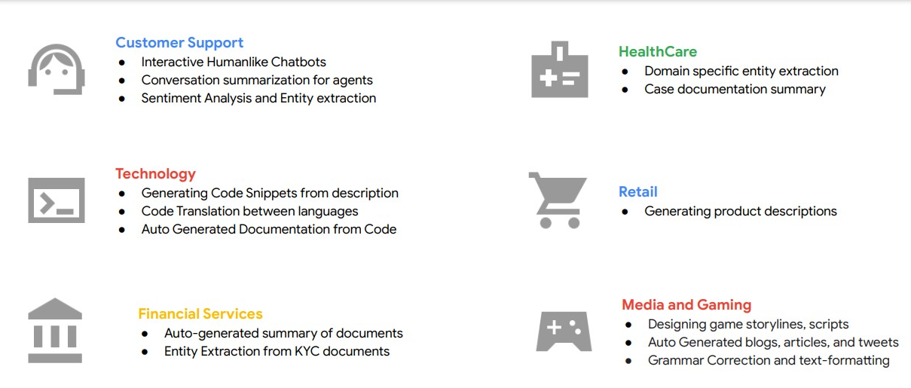
LLM APPLICATION IN INDUSTRY

Slide 40


Slide 41
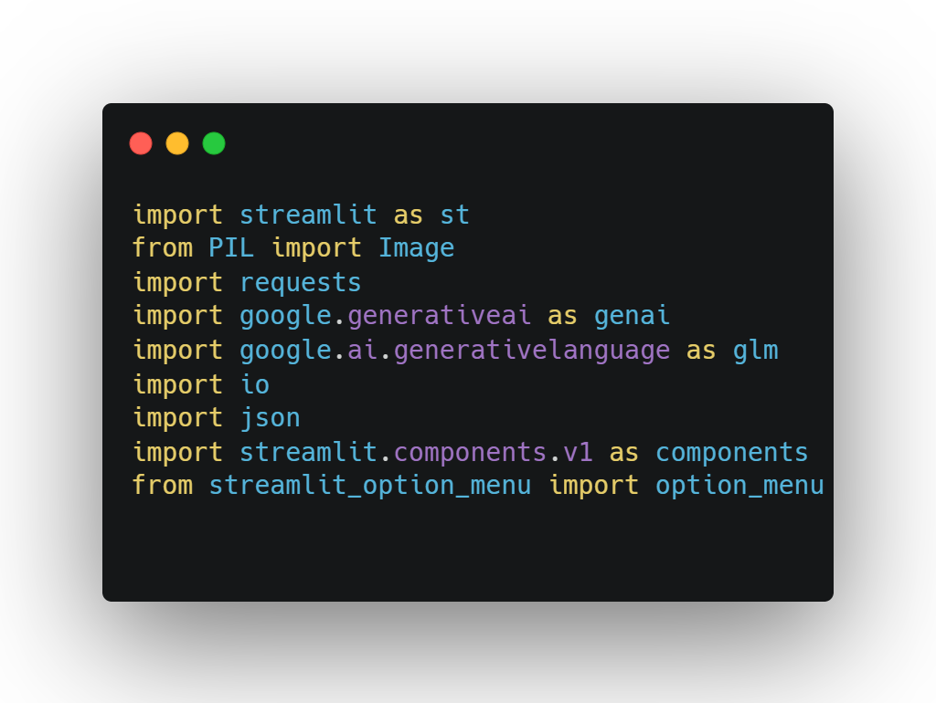
DEMO

Slide 42

DEMO

Slide 43
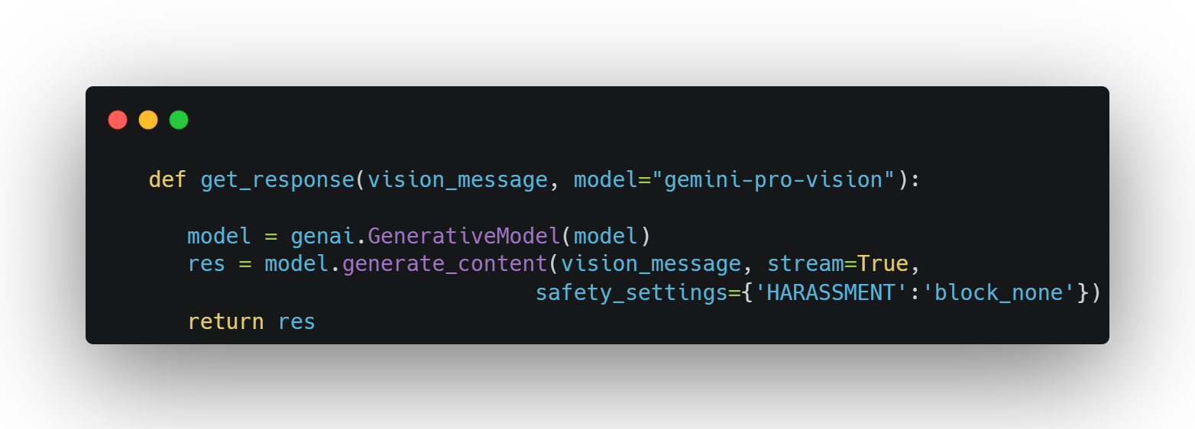
DEMO

Slide 44
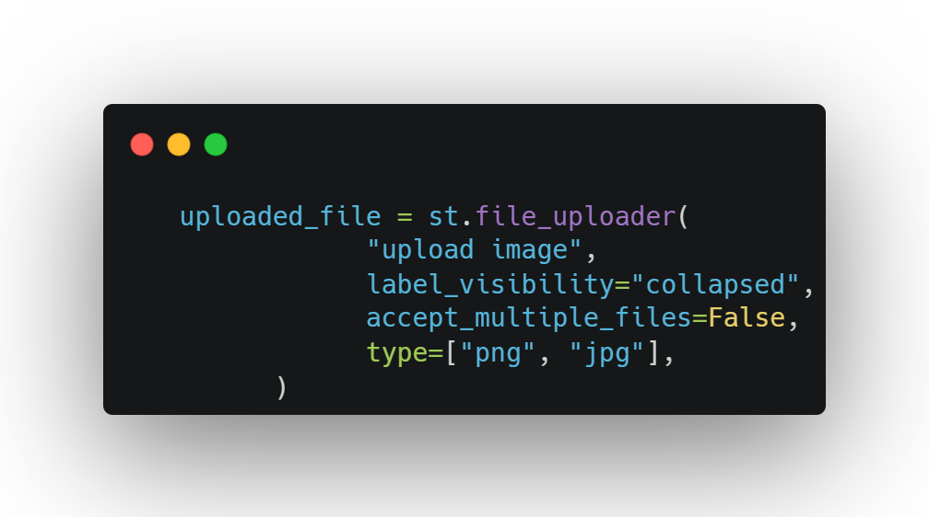
DEMO

Slide 45
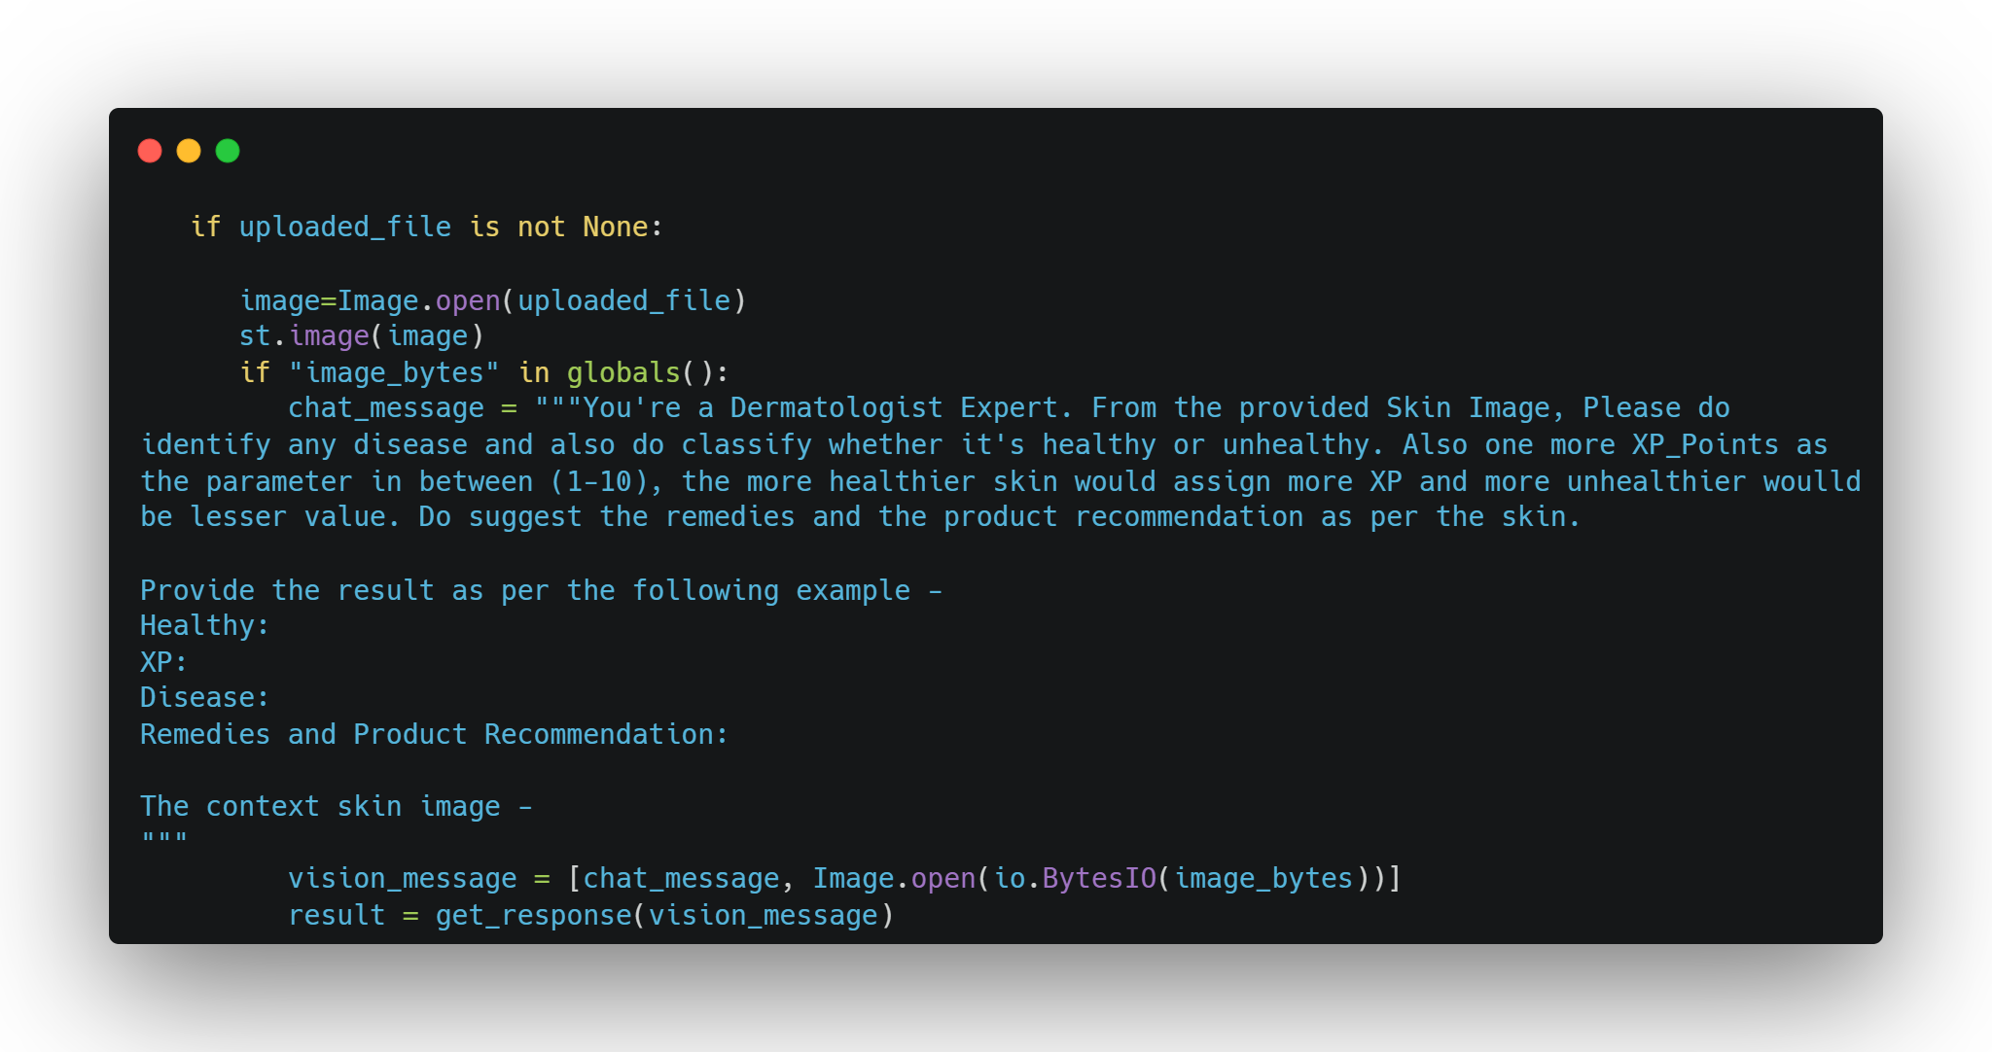

Slide 46


Slide 47
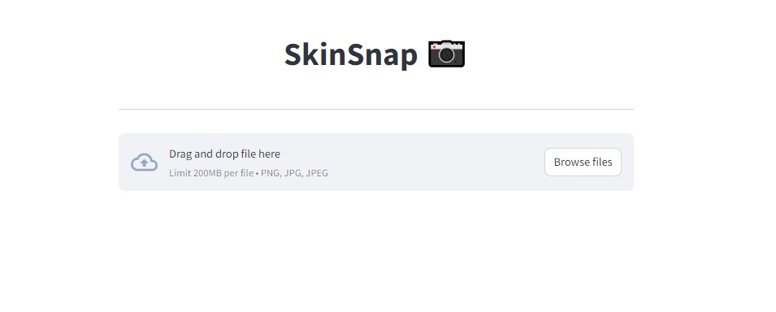

Slide 48
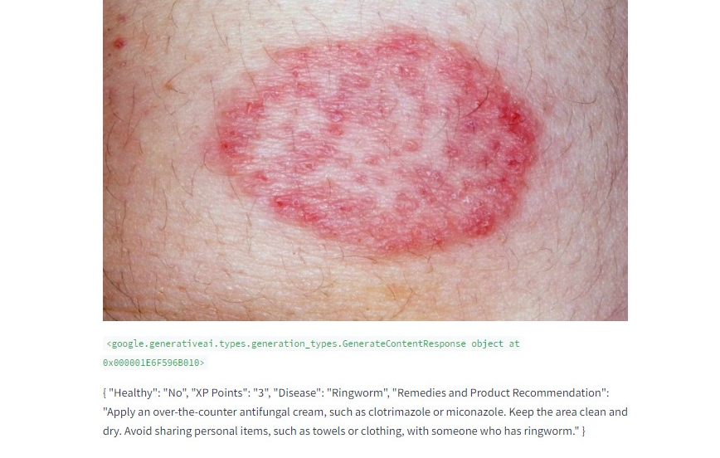

Slide 49


RESOURCES AND
URL
Scan the QR

Slide 50

MORE RESOURCES AND PATHWAYS
Scan the QR

Slide 51

ABOUT
Co-Founder @RetroNexus
Member @SuperTeamDao
AI Lead @TCET OpenSource
AI Instructor @RanchoLabs
Student Ambassador @Strealmit
Twitter - @hrishikesh_ai

Slide 52
